Slide 1


Mediator
Mediator pattern

Slide 2


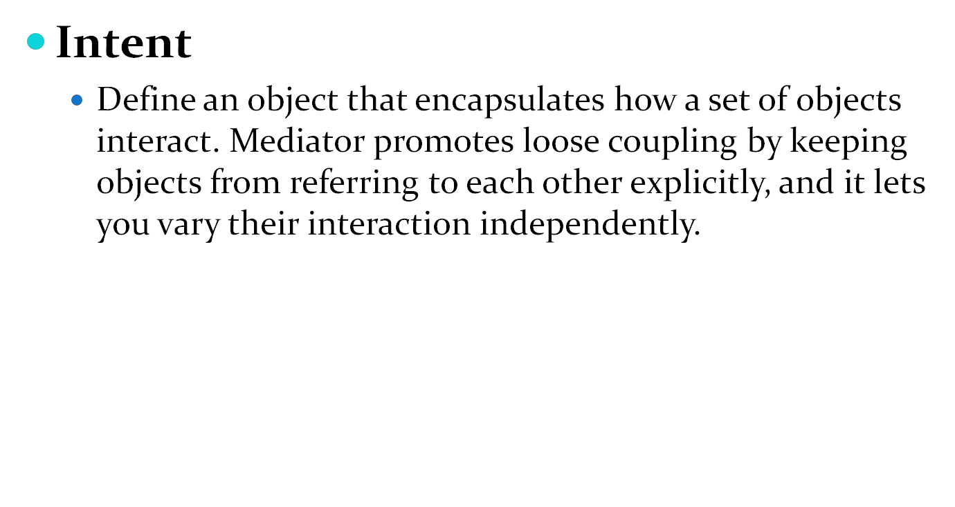

Slide 3
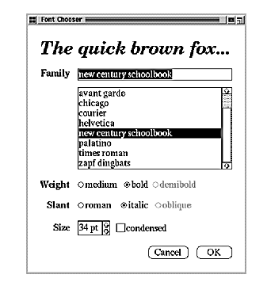
Motivation
Object-oriented design encourages the distribution of
behavior among objects. Such distribution can result in an
object structure with many connections between objects;
in the worst case, every object ends up knowing about every other.
As an example, consider the implementation of dialog
boxes in a graphical user interface. A dialog box uses a window to present a collection of widgets such as buttons,
menus, and entry fields, as shown here:
Often there are dependencies between the widgets in the
dialog. For example, a button gets disabled when a certain
entry field is empty. Selecting an entry in a list of choices called a list box might change the contents of an entry
field..

Slide 4
Motivation
Different dialog boxes will have different dependencies between widgets.
You can avoid these problems by encapsulating collective behavior in a
separate mediator object. A mediator is responsible for controlling and
coordinating the interactions of a group of objects.
For example, FontDialogDirector can be the mediator between the widgets
in a dialog box. A FontDialogDirector object knows the widgets in a dialog and
coordinates their interaction. It acts as a hub of communication for widgets.

Slide 5
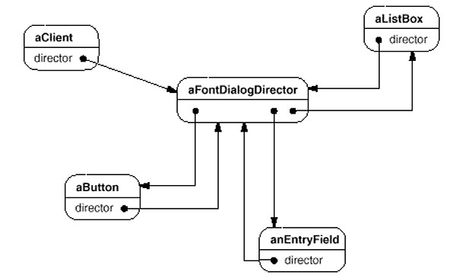
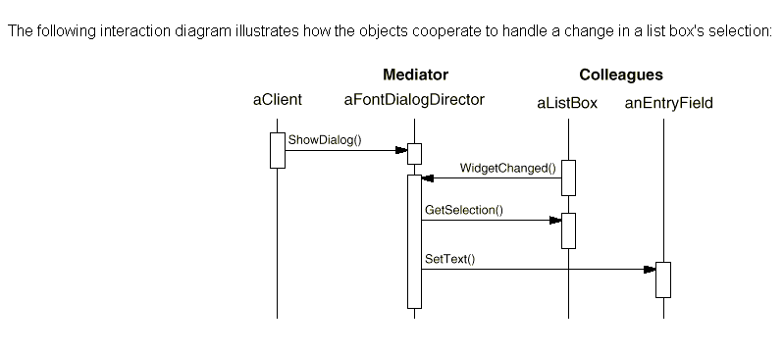
Motivation

Slide 6
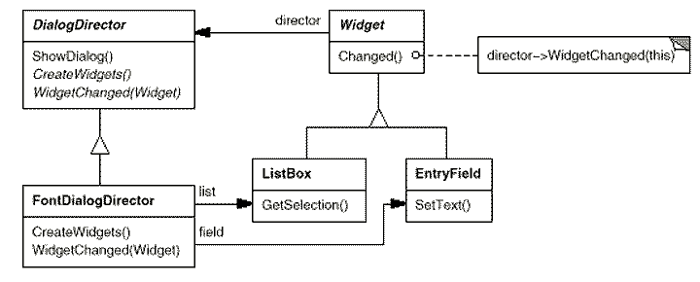
Motivation
Here's how the FontDialogDirector abstraction can be integrated into a class library:

Slide 7
Applicability
Use the Mediator pattern when
a
set of objects communicate in well-defined but complex ways.
reusing an object is difficult because it refers to and communicates with many other objects.

Slide 8
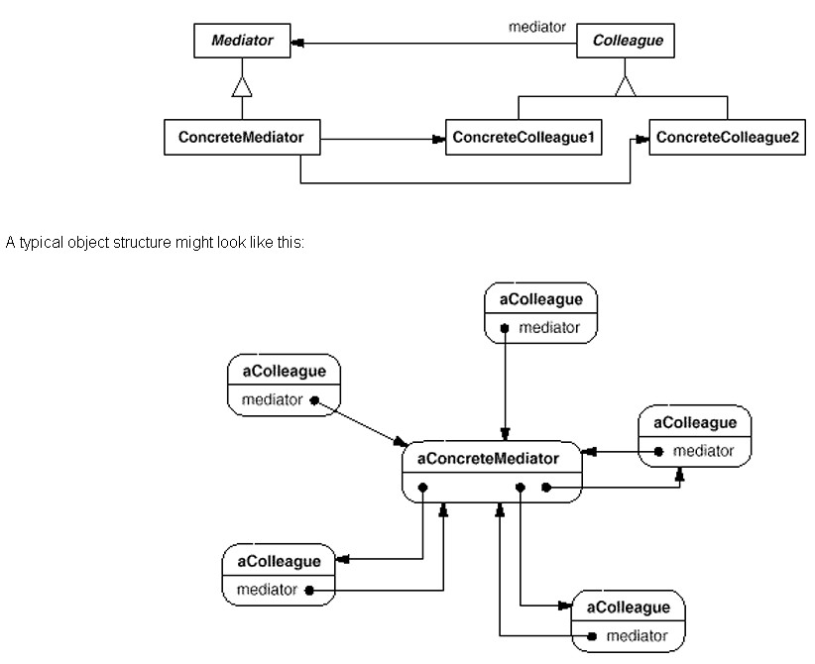
Structure

Slide 9
Participants
Mediator (DialogDirector)
defines an interface for communicating with Colleague objects.
ConcreteMediator (FontDialogDirector)
implements cooperative behavior by coordinating Colleague objects.
knows and maintains its colleagues.
Colleague classes (ListBox, EntryField)
each Colleague class knows its Mediator object.
each colleague communicates with its mediator whenever it would have otherwise communicated with another colleague.

Slide 10
Collaborations
Colleagues send and receive requests from a Mediator object. The mediator implements the cooperative behavior by routing requests between the appropriate colleagues.

Slide 11
It limits subclassing. A mediator localizes behavior that otherwise would be distributed
among several objects. Changing this behavior requires subclassing Mediator only;
Colleague classes can be reused as is.
Consequences
The Mediator pattern has the following benefits and drawbacks:
It limits sub classing. A mediator localizes behavior that otherwise would be distributed among several objects.
It decouples colleagues. A mediator promotes loose coupling between colleagues. You can vary and reuse Colleague and Mediator classes independently.
It simplifies object protocols. A mediator replaces many-to-many interactions with one- to-many interactions between the mediator and its colleagues. One-to-many relationships are easier to understand, maintain, and extend.
.
I
.

Slide 12
USES
This pattern is used in:
  Air traffic control systems.
  911 Emergency dispatching
  Matrix software research
  GUI dialog managers
  COM run-time
  IIS Webserver

Slide 13
RELATED PATTERNS
  Observer
  Facade

